Slide 1

FULL-STACK DEVELOPMENT INTERNSHIP
Internship Presentation
Student Name
PUSHKAR NARAYAN
Admission No.
25SCS1003005607
Program & Semester
B.Tech CSE | Semester: 3rd
Batch
2025 – 2029
Organization
Prodigy InfoTech
Internship Period
1 August 2026 – 1 September 2026
School of Computer Science and Engineering
IILM University, Greater Noida, U.P.

Slide 2
Internship Overview
A practical full-stack web development internship focused on building and understanding web application workflows.
1 Aug 2026
Task-based work
Testing
1 Sep 2026
Internship begins
Frontend + backend + database
Browser, API and database testing
Internship completion
Task track
Internship focus
• 01 Secure User Authentication
• 02 Employee Management System
• 03 Local Store E-commerce Platform
• 04 Real-Time Chat Application
• 05 Social Media Platform
• User-facing web interfaces
• Server-side APIs and application logic
• Authentication, validation and secure handling
• MongoDB-backed data storage
• Testing, debugging and documentation
Pushkar Narayan | Full-Stack Development Internship | Prodigy InfoTech
2

Slide 3
What is Full-Stack Development?
Core Layers
Internship Scope
• Front-end — HTML, CSS, JavaScript and responsive UI • Back-end — Node.js, Express.js, REST APIs and application logic • Database — MongoDB / Mongoose for persistent data • Deployment — preparing and hosting the application for users
• Secure authentication and protected resources • Employee CRUD workflows • E-commerce catalogue and shopping flow • Real-time communication concepts • Social media interaction concepts • Testing, debugging, Git/GitHub and documentation
Pushkar Narayan | Full-Stack Development Internship | Prodigy InfoTech
3

Slide 4
Technologies & Tools
HTML5
CSS3
JavaScript
Page structure, forms and content
Layout, styling and responsive presentation
Client-side interaction and logic
Node.js
Express.js
MongoDB / Mongoose
Server-side JavaScript runtime
Backend server and API routes
Persistent data and database operations
bcrypt
JWT
VS Code
Password hashing
Token-based authentication
Development environment
Git / GitHub
Version control and submission
Core implementation: Secure User Authentication using Node.js, Express.js, MongoDB, bcrypt and JWT. Deployment concepts were covered as part of the full-stack workflow.
Pushkar Narayan | Full-Stack Development Internship | Prodigy InfoTech
4

Slide 5
Project Overview – Secure User Authentication
Problem: secure login, protected resources and safe credential storage; solution: a full-stack authentication workflow.
Front-end / UI
Node.js + Express
Security Layer
HTML • CSS • JavaScript
REST APIs • validation • logic
bcrypt • JWT • protected routes
MongoDB
User records • persistence
Features: registration, login, hashing, JWT authentication and protected routes | Contribution: UI, APIs, database integration, testing and debugging
Pushkar Narayan | Full-Stack Development Internship | Prodigy InfoTech
5

Slide 6
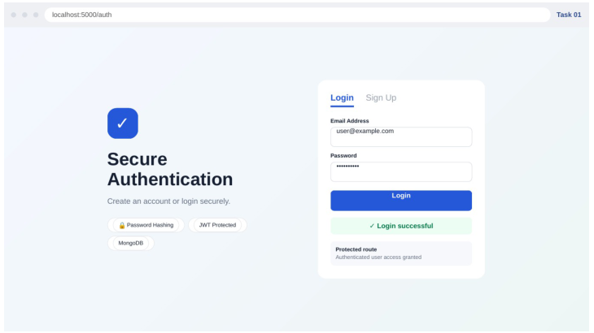
Task 1 – Secure User Authentication
Task objective
Implement secure sign-up, login and protected-route access.
Key features demonstrated
• Login and registration interface
• Password hashing
• JWT-based authentication
• Protected route access
• MongoDB-backed user records
Working output documented in the report.
Pushkar Narayan | Full-Stack Development Internship | Prodigy InfoTech
6

Slide 7
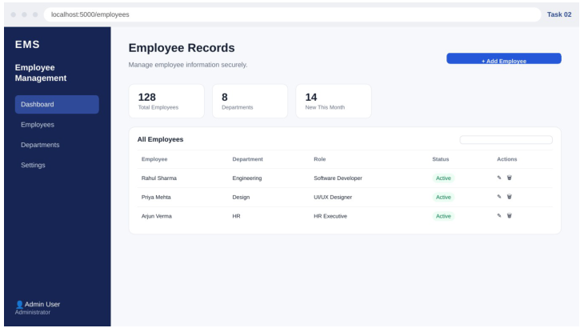
Task 2 – Employee Management System
Task objective
Enable administrators to perform CRUD operations on employee records with validation and authentication.
Key features demonstrated
• Employee dashboard
• Add / read / update / delete controls
• Department and role information
• Searchable employee records
• Authenticated administrative interface
Pushkar Narayan | Full-Stack Development Internship | Prodigy InfoTech
7

Slide 8
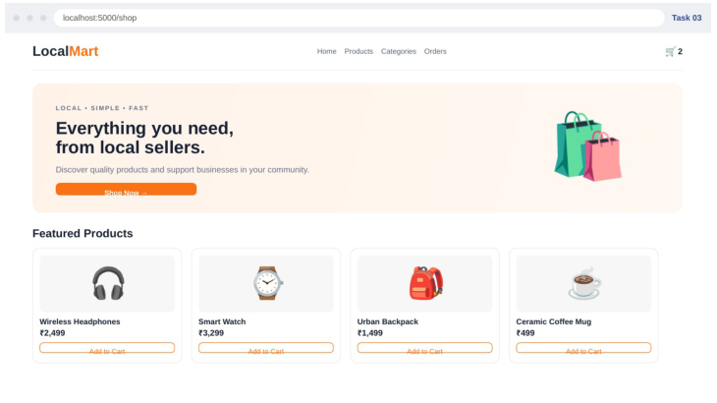
Task 3 – Local Store E-commerce Platform
Task objective
Enable customers to browse products and purchase through a practical shopping interface.
Key features demonstrated
• Product catalogue
• Product cards and prices
• Shopping cart indicator
• Category/navigation interface
• Add-to-cart interaction
Pushkar Narayan | Full-Stack Development Internship | Prodigy InfoTech
8

Slide 9
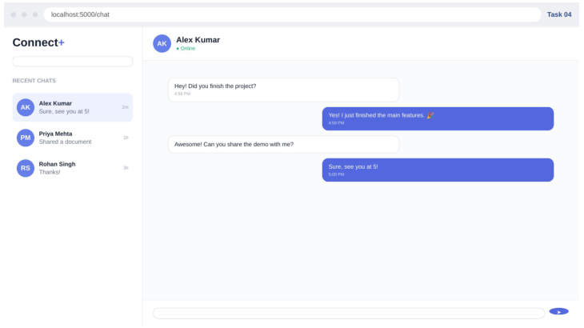
Task 4 – Real-Time Chat Application
Task objective
Use WebSocket technology to enable instant messaging between users.
Key features demonstrated
• Conversation list
• Online status
• Message history
• Sender/receiver message styling
• Message composer
Pushkar Narayan | Full-Stack Development Internship | Prodigy InfoTech
9

Slide 10
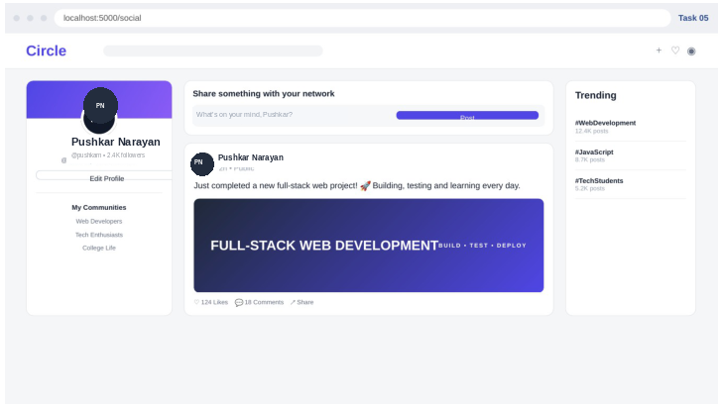
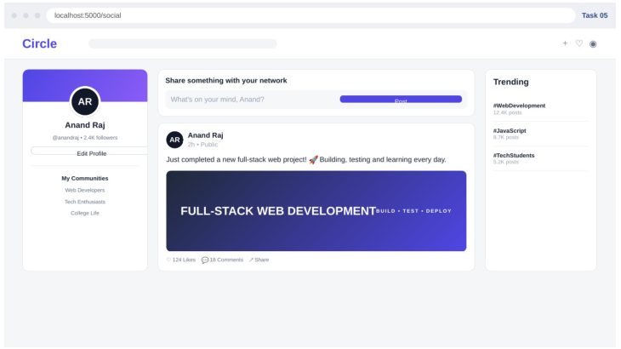




Task 5 – Social Media Platform
Task objective
Allow users to create profiles, share posts and interact with other users.
Key features demonstrated
• User profile
• Post composer
• Feed-style post
• Likes / comments / share controls
• Trending topics
Pushkar Narayan | Full-Stack Development Internship | Prodigy InfoTech
10

Slide 11
Results & Learning Outcomes
The internship connected requirements, implementation, testing and documentation across a range of web application concepts.
Key outcomes
Development workflow
• Improved understanding of full-stack web application structure.
• Practical experience with HTML, CSS, JavaScript, Node.js and Express.js.
• Experience with MongoDB, REST APIs and authentication workflows.
• Improved debugging, API testing and problem-solving skills.
• Hands-on use of Git/GitHub for version control and submission.
• Developed communication, teamwork and task-planning skills.
• Exposure to iterative/agile-style development and technical documentation.
1
Requirement
2
UI / Structure
3
Backend / Data
4
Testing
5
Documentation
Pushkar Narayan | Full-Stack Development Internship | Prodigy InfoTech
11

Slide 12
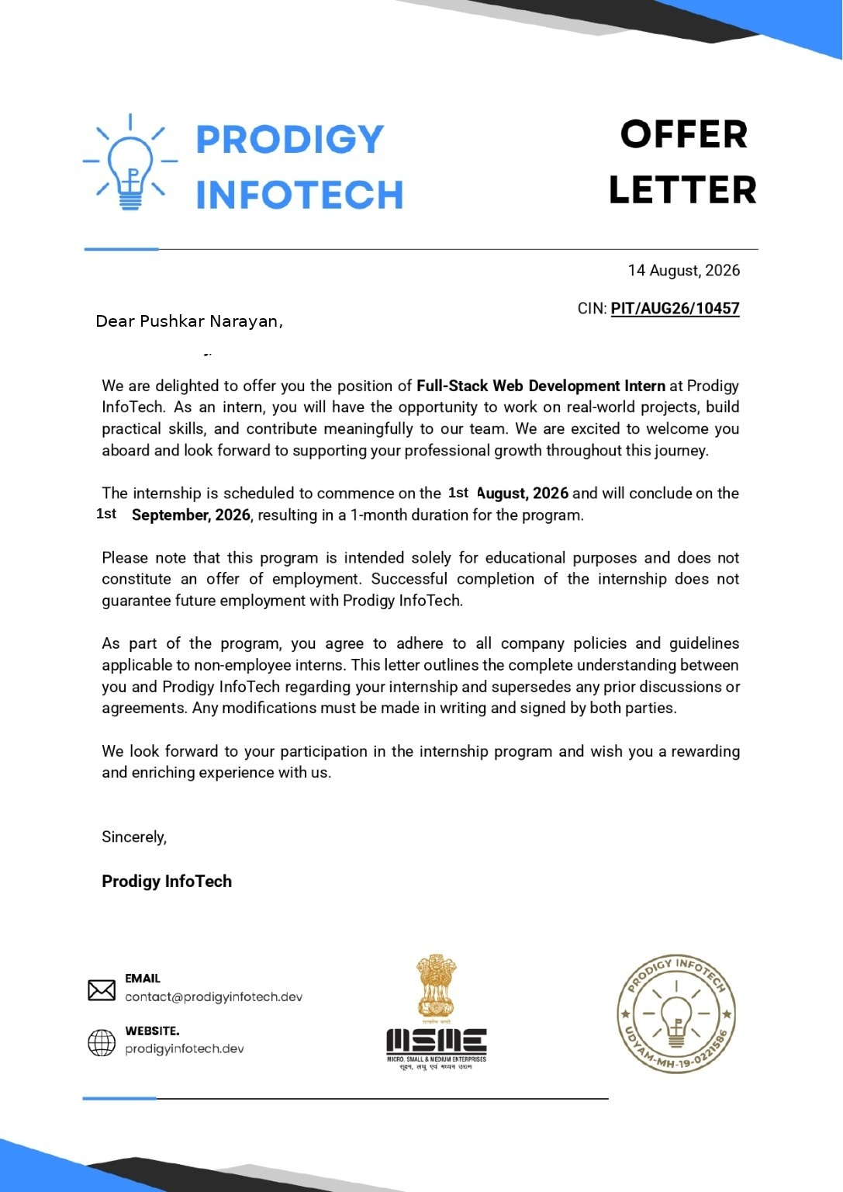
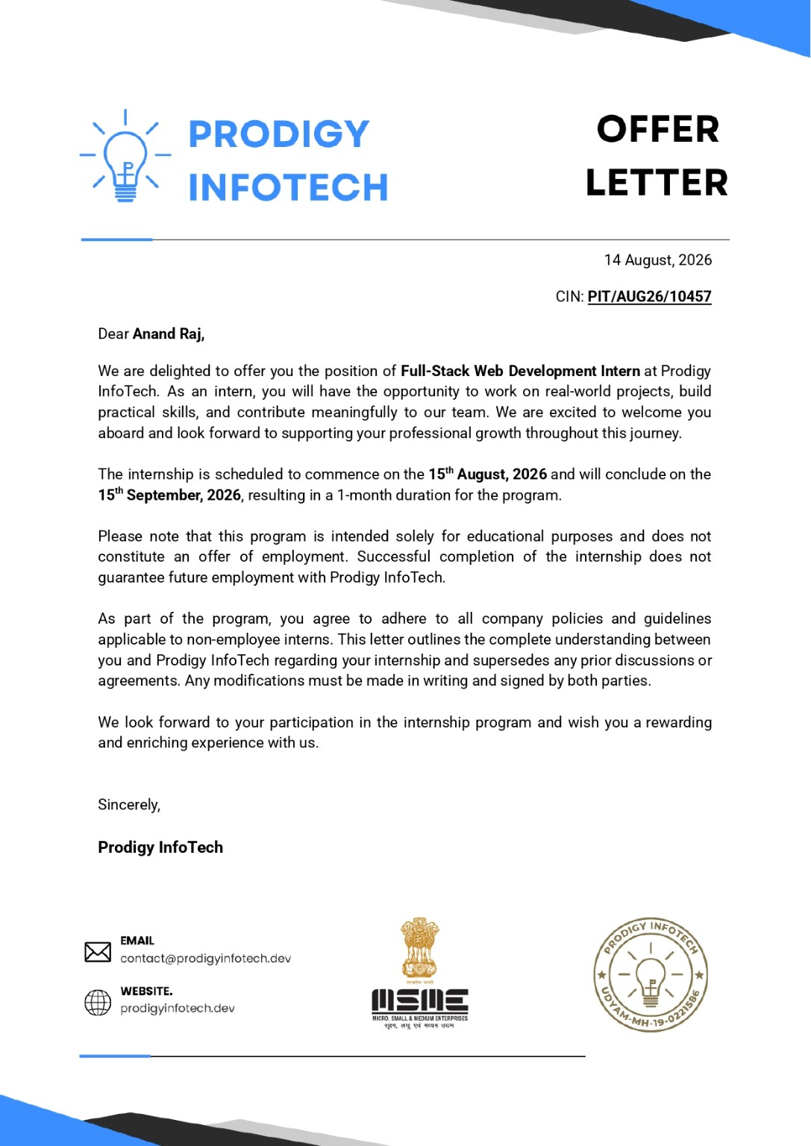
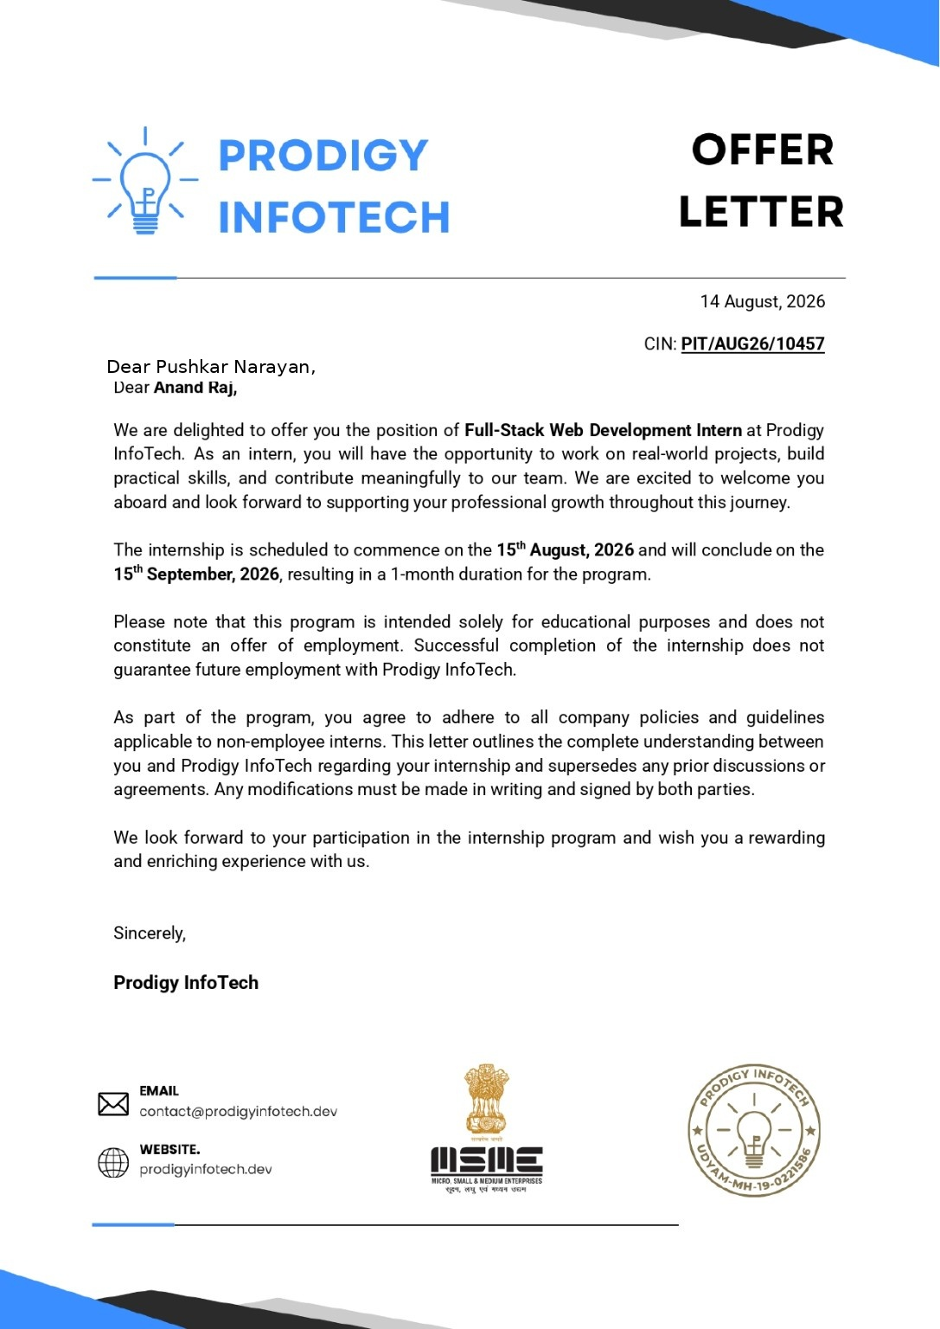


Supporting Document – Offer Letter
Pushkar Narayan | Full-Stack Development Internship | Prodigy InfoTech
12

Slide 13
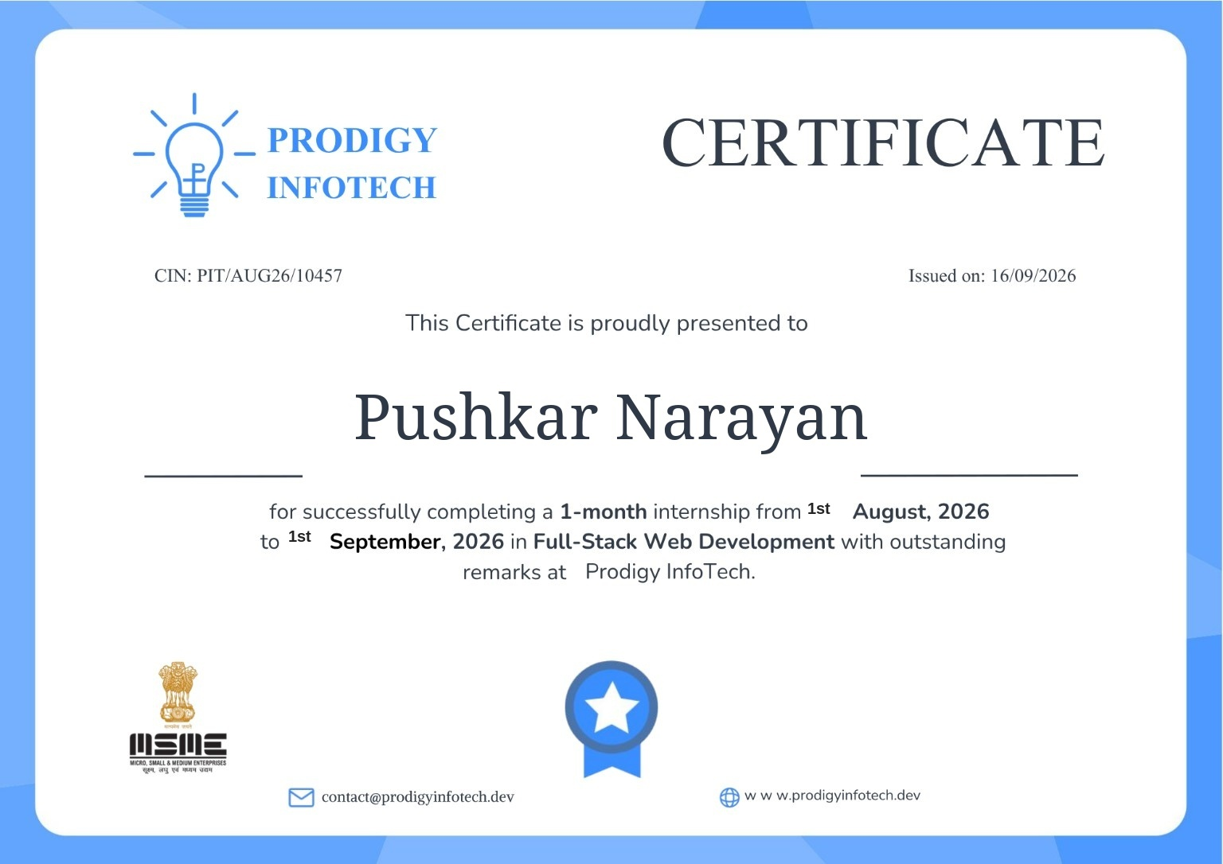
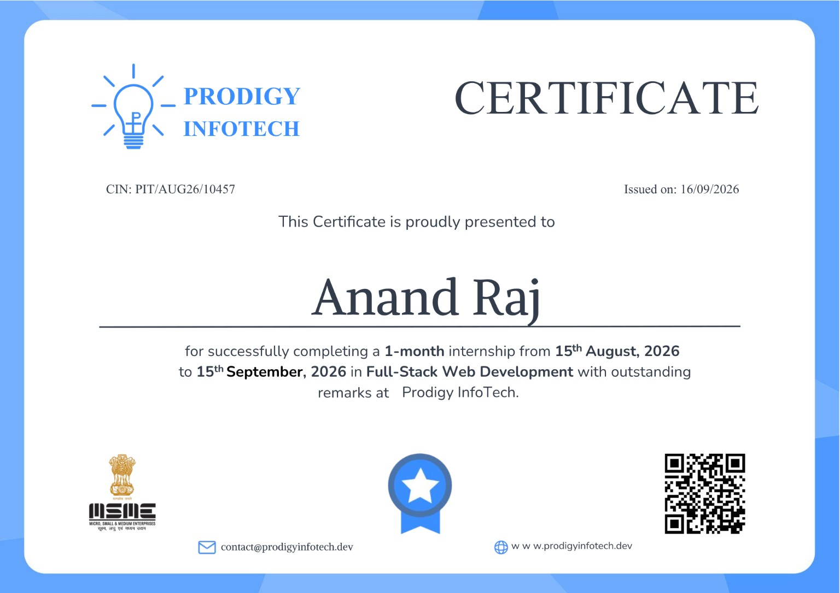
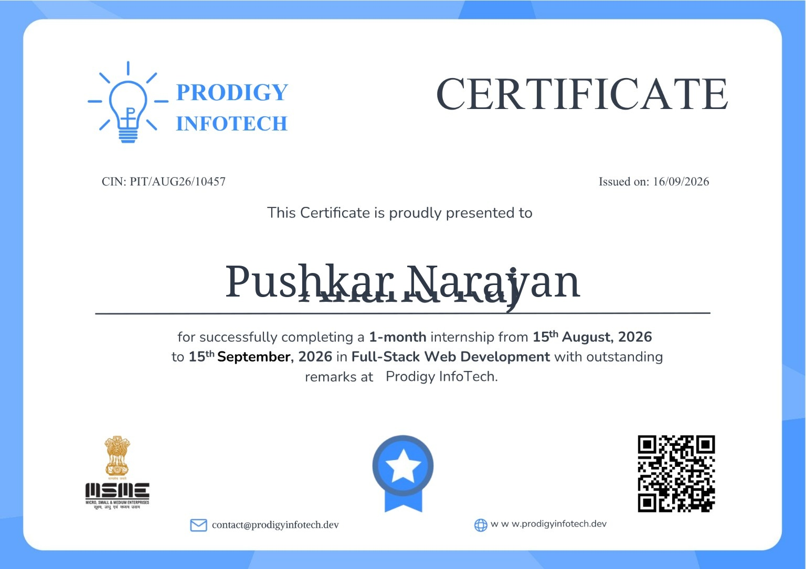
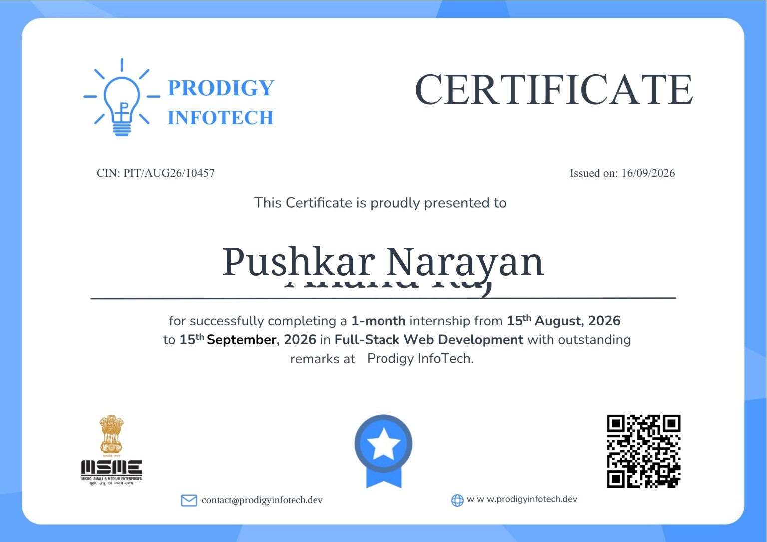
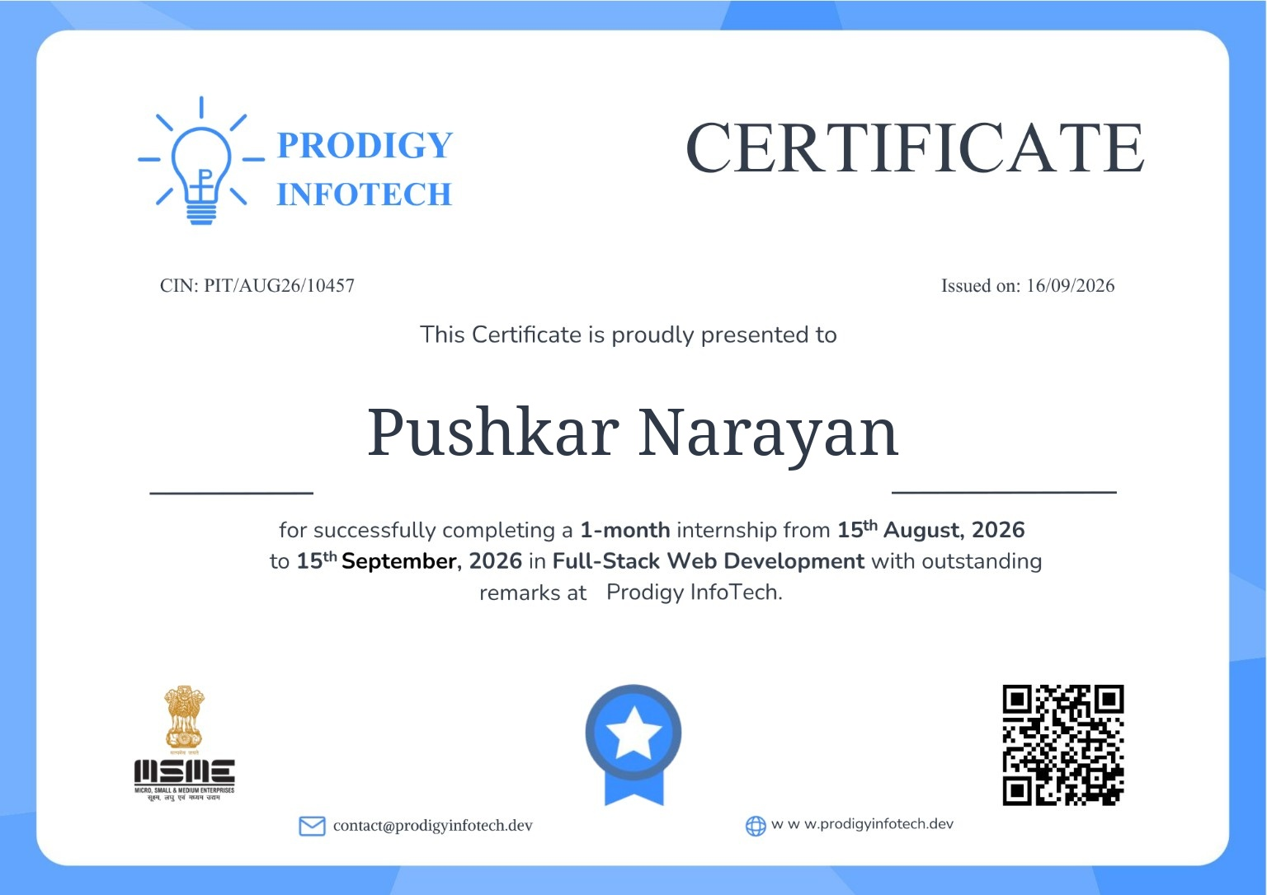
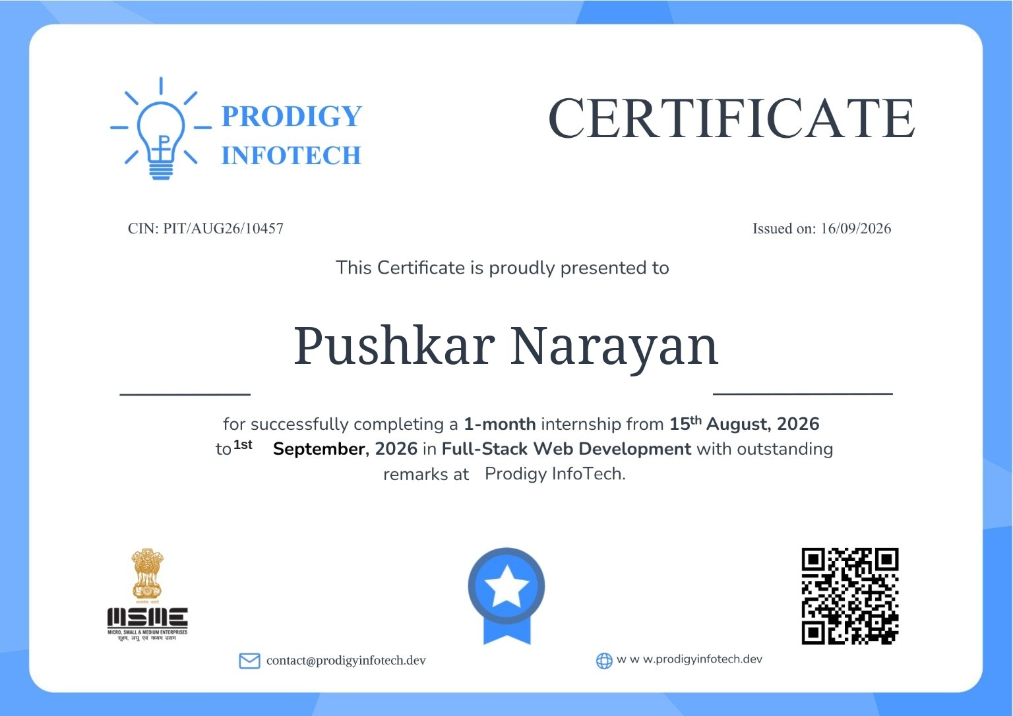
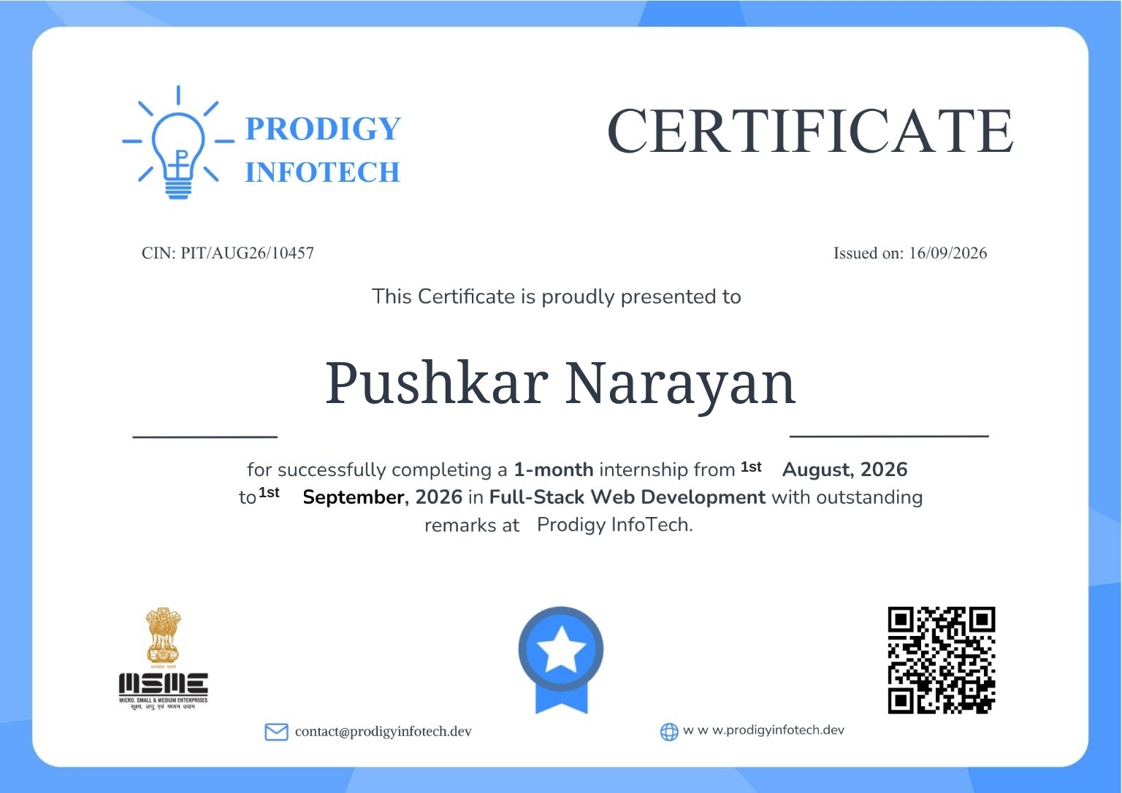


Supporting Document – Internship Completion Certificate
Pushkar Narayan | Full-Stack Development Internship | Prodigy InfoTech
13

Slide 14
Conclusion
Thank You
Full-Stack Development Internship
Prodigy InfoTech
The internship strengthened my practical skills in full-stack development, authentication, REST APIs, database connectivity, testing, version control and technical documentation.
PUSHKAR NARAYAN | B.Tech CSE | IILM University, Greater Noida
Pushkar Narayan | Full-Stack Development Internship | Prodigy InfoTech
14

